Slide 1
DBMS SQL

Slide 2
Outline
Overview of SQL
Data Definition Command
Data Manipulation command
Data Control Commands
Transaction control commands

Slide 3
Set and string operations. Aggregate function
Group by, Having
Views, Joins
Nested queries, Complex queries
Integrity Constraints
Triggers

Slide 4
SQL
Structure Query Language(SQL) is a database query language used for storing and managing data in Relational DBMS.
SQL was the first commercial language introduced for E.F Codd's Relational model of database.
Today almost all RDBMS(MySql, Oracle, Infomix, Sybase, MS Access) use SQL as the standard database query language.
SQL is used to perform all types of data operations in RDBMS.

Slide 5
SQL is case insensitive. But it is a recommended practice to use keywords (like SELECT, UPDATE, CREATE, etc) in capital letters and use user defined things (liked table name, column name, etc) in small letters.
SQL is the programming language for relational databases (explained below) like MySQL, Oracle, Sybase, SQL Server, Postgre, etc. Other non-relational databases (also called NoSQL) databases like MongoDB, DynamoDB, etc do not use SQL

Slide 6
Advantages
High level language which provides greater degree of abstraction.
Application written can be easily ported across system.
It specifies what is required and how it should be done.
Language is simple and easy to learn.

Slide 7
SQL Data Type
Numeric
Character String
Bit String
Boolean
Date time

Slide 8
Numeric Data types
This data type is used to store a number values that can be decimal or floating point values.
Syntax- int
Integer
123,14
Syntax-float
11.5

Slide 9
Character String data type
Char(10)
mohan ……………………add 5 space bar
Varchar(10)
abc…………….only 3 digits occupied

Slide 10
Date time data type
Date
format YEAR-MONTH-DATE
Eg: 2020-07-15
Time
Format HH:MM:SS
Eg: 11:34:45

Slide 11
SQL commands
DDL – Data Definition Language
DML – Data Manipulation Language
DCL – Data Control Language
TCL-Transaction control Language

Slide 12
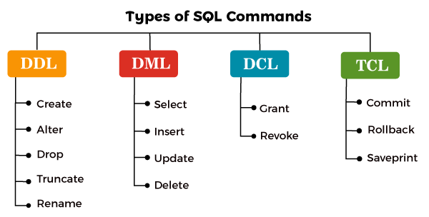

Slide 13
DDL
DDL stands for Data Definition Language.
It is a language used for defining and modifying the data and its structure.
It is used to build and modify the structure of your tables and other objects in the database.

Slide 14
DDL commands
DDL commands are as follows, 1. CREATE 2. DROP 3. ALTER 4. RENAME 5. TRUNCATE

Slide 15
CREATE COMMAND
CREATE command is used for creating objects in the database.
It creates a new table.
Syntax: CREATE TABLE <table_name> ( column_name1 datatype, column_name2 datatype, . . column_name_n datatype );

Slide 16
Example : CREATE command
CREATE TABLE Employee ( empid INT, ename CHAR(8), age INT, city CHAR(25), phone_no INT );

Slide 17
Create
Employee
Empid | Ename | Age | City | Phone_no

Slide 18
DROP COMMAND
DROP command allows to remove entire database objects from the database.
It removes entire data structure from the database.
It deletes a table, index or view.

Slide 19
Syntax:
DROP TABLE <table_name>;
OR
DROP DATABASE <database_name>;

Slide 20
Example : DROP Command
DROP TABLE employee; OR DROP DATABASE employees;

Slide 21
ALTER COMMAND
An ALTER command allows to alter or modify the structure of the database.
It modifies an existing database object.
Using this command, you can add additional column, drop existing column and even change the data type of columns.

Slide 22
Syntax:
ALTER TABLE <table_name> ADD <column_name datatype>; OR ALTER TABLE <table_name> CHANGE <old_column_name> <new_column_name>; OR ALTER TABLE <table_name> DROP COLUMN column_name;

Slide 23
Example : ALTER Command
ALTER TABLE employee ADD (address varchar(50)); OR ALTER TABLE employee CHANGE (phone_no) (contact_no); OR ALTER TABLE employee DROP COLUMN age;

Slide 24
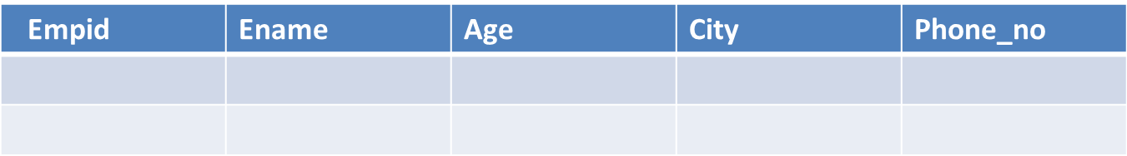
ALTER TABLE employee
ADD Salary int;
Empid | Ename | Age | City | Phone_no | Salary

Slide 25
ALTER TABLE employee CHANGE (phone_no) (contact_no);
Empid | Ename | Age | City | Contact_no | Salary

Slide 26
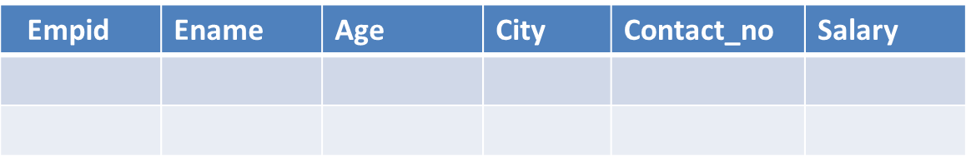
ALTER TABLE employee DROP COLUMN age;
Empid | Ename | City | Contact_no | salary

Slide 27
RENAME COMMAND
RENAME command is used to rename an object.
It renames a database table.

Slide 28
Syntax
RENAME TABLE <old_name> TO <new_name>;
Example: RENAME TABLE Employee TO Emp;

Slide 29
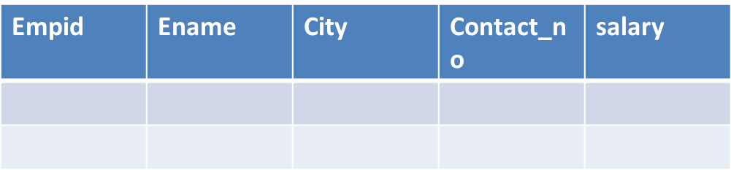

Employee
Employee
RENAME TABLE Employee TO emp;
Emp

Slide 30
TRUNCATE COMMAND
TRUNCATE command is used to delete all the rows from the table permanently.
It removes all the records from a table, including all spaces allocated for the records.
This command is same as DELETE command, but TRUNCATE command does not generate any rollback data.

Slide 31
Syntax: TRUNCATE TABLE <table_name>;
Example:
TRUNCATE TABLE employee;

Slide 32
Thank you !

